Slide 1
Selenium IDE

Slide 2
Version Control and Revision History
 | Name | Date
Prepared By | Manisha Mane | 01-Aug-2018
Reviewed By | Nisha Mendonsa | 02-Aug-2018
Approved By | Gauresh Gaitonde | 02-Aug-2018
Version No. | Date | Section Affected | Highlight of Changes
1.0.0 | 23-Mar-2017 | All | Original Version.
2.0.0 | 02-Aug-2018 | New topics added | Added Topics such as TestNG, Selenium with web driver

Slide 3








Iconic Representations.......
Test your Memory
Can you Solve?
Objective
Coffee Break
Queries
Recap
Need more Info
Brainstorm

Slide 4
Agenda for the session
Selenium History
Why the Name Selenium?
Selenium Features
Selenium Architecture
Selenium Components
Overall Workflow of Selenium
Selenium verses QTP
Selenese Commands
Synchronization commands
Locating Elements

Slide 5
Selenium History
Selenium was originally developed by Jason Huggins in 2004 as an internal tool at ThoughtWorks
Paul Hammant joined the team and steered the development of the second mode of operation that would later become 'Selenium Remote Control' (RC).
In 2007, Simon Stewart at ThoughtWorks developed a superior browser automation tool called WebDriver.
In 2009, after a meeting between the developers at the Google Test Automation Conference, it was decided to merge the two projects, and call the new project Selenium WebDriver, or Selenium 2.0.
In 2008, Philippe Hanrigou (then at ThoughtWorks) made 'Selenium Grid', which provides a hub allowing the running of multiple Selenium tests concurrently on any number of local or remote systems, thus minimizing test execution time.

Slide 6

Why the name Selenium?
The name Selenium comes from a joke made by Huggins in an email, mocking a competitor named Mercury, saying that “you can cure mercury poisoning by taking selenium supplements”.

Slide 7
Introduction to selenium
Selenium is a free (open source) automated testing suite for web applications across different browsers(IE 6/7, Firefox, Opera, Safari 2.0+) and platforms (Windows, Linux, and Macintosh).
Selenium allows scripting in several languages like Java, C#, PHP and Python.
Selenium is not just a single tool but a suite of software's, each catering to different testing needs of an organization. It has four components.
Notes:
Preamble :
What is testing ?
ans.> Software testing can be stated as the process of validating and verifying that a computer program/application/product:
i>meets the requirements that guided its design and development,
ii>works as expected,
iii>can be implemented with the same characteristics,
iv> satisfies the needs of stakeholders.
What is automation ?
ans.> Automation in testing is a process to automate the manual test process.
Why automation?
Ans.> In manual testing process we have to perform some testing multiple times. It is time consuming as it have been done manually. To reduce the manual effort and errors we are going for the automation testing. It is time reducing and more error free than manual testing.
Brief overview of automation tools
Ans.> We automate the process using different tools:
1. Selenium
2. QTP
3. Load Runner
etc.

Slide 8
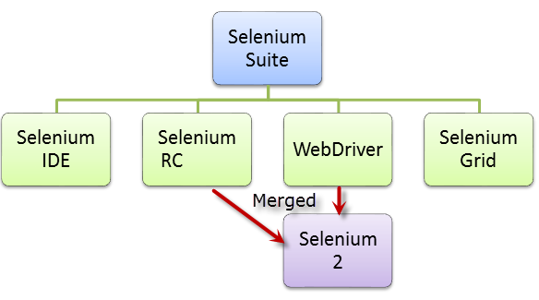
Selenium Architecture
Notes:
Evolution of Selenium:
Selenium is an automation tool for web application.
Selenium have for different type according to its functionality like Selenium IDE, Selenium RC, WebDriver, Selenium Grid.
Selenium IDE →This is basically a plugin. It is supported only by Firefox. It does record and play operation. And it has the privileges to export JUnit code. We also export the code in C#, Python, Ruby.
Selenium RC → - Here we create an server from which the code is executed and result will be shown in requesting machine.
WebDriver → - This is the first cross platform testing framework that could control the browser from the OS level.
Selenium Grid → It is also have the same privileges as Selenium RC. It has more extra features like
1> We can create parallel execution process.
2> We can test the application from different browser at single instance of time
3> It has capable of capturing browser screenshots during significant stages, and also of sending out Selenium commands to different machines simultaneously

Slide 9
Selenium Components
Selenium IDE
A Firefox extension that can automate the browser through a record-and-playback feature.
To further increase the speed in creating test cases
WebDriver
when browsers and web applications were becoming more powerful and more restrictive with JavaScript programs like Selenium Core.
It was the first cross-platform testing framework that could control the browser from the OS level.

Slide 10
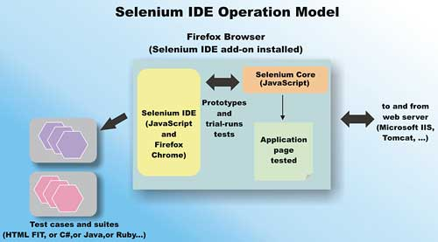
Workflow of Selenium IDE
Notes:
Workflow of selenium IDE:
Selenium IDE records the flow of testing process of an web application in its recommended place called test suit. Then it runs the application according to the recorded process. It only works with Firefox browser. We can also export the process in different language like JAVA, C#, Ruby, Python ,PHP.

Slide 11
Pros & Cons
Selenium IDE
Pros
→ Very easy to use & install.
→ Can export tests to formats usable in selenium RC & WebDriver.
→ Has built- in help & test results reporting module.
→ Provides support for extensions
Cons
Available only in Firefox.
Designed only to create prototypes of test
No support for iteration & conditional operations.
Test execution is slow compared to that of selenium RC & WebDriver.

Slide 12
Selenium Components
Selenium Remote Control (Selenium RC)
Selenium RC is a server, written in java, that accepts commands for the browser via HTTP.
During the Early Stages testers using Selenium Core had to install the whole application under test and the web server on their own local computers
Later ThoughtWork’s, decided to create a server that will act as an HTTP proxy to “trick” the browser into believing that Selenium Core and the web application being tested come from the same domain.

Slide 13
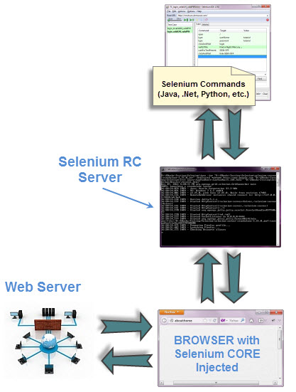
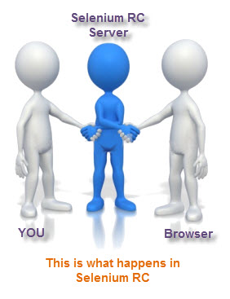
Selenium Remote Control
It is also known as Selenium 1, which is the first Selenium tool that allowed users to use programming languages in creating complex tests

Slide 14
Pros & Cons
Selenium Remote Control (Selenium RC)
Pros
→ Cross browser & cross platform.
→ Can perform looping & Conditional Operations
→ Can support data driven testing
Has matured & complete API
Can readily support new browsers
Faster execution than IDE
Cons
Installation is more complicated than IDE
Must have programming knowledge
Needs Selenium RC server to be running
Browser interaction is less realistic
Inconsistent result & users JavaScript
Slower execution time than WebDriver

Slide 15
Selenium Components
Selenium Grid
To address the need of minimizing test execution times as much as possible.
Initially called the system “Hosted QA.”
It was capable of capturing browser screenshots during significant stages, and also of sending out Selenium commands to different machines simultaneously

Slide 16
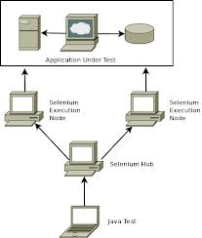
Workflow of Selenium Grid
Notes:
Workflow of Selenium Grid:
Selenium Grid has two components: Selenium Hub and Remote Control. The hub receives requests from tests (the same as Selenium RC), and then allocates remote controls that are registered to the hub to each test.

Slide 17
Selenium Components
Web Driver
when browsers and web applications were becoming more powerful and more restrictive with JavaScript programs like Selenium Core.
It was the first cross-platform testing framework that could control the browser from the OS level.

Slide 18
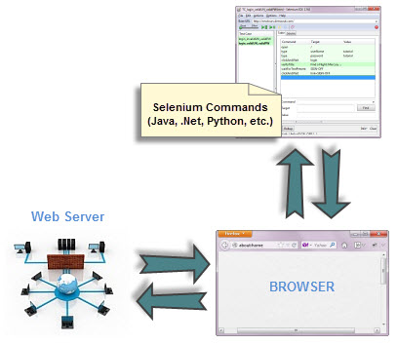

Selenium Web driver
The Web Driver proves itself to be better than both Selenium IDE and Selenium RC in many aspects.
It implements a more modern and stable approach in automating the browser’s actions.
It controls the browser by directly communicating to it.

Slide 19
Pros & Cons
WebDriver
Pros
→Communicates directly to the browser.
→Browser interaction is more realistic
No Need to start a server.
Faster execution time than IDE and RC
Cons
Requires programming knowledge.
Cannot readily support new browsers

Slide 20
Limitation of the selenium
It does not support a non web-based applications
No inbuilt reporting capability so you need plugins like JUnit and TestNG for test reports

Slide 21
Exercise :
Login to PeopleSoft finance Application.

Slide 22


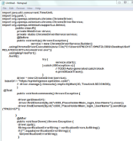





Overall Workflow of Selenium
Web application actions
Exporting recorded script
Developer Tools
……..
…….
….
Running Script
In different browsers
Notes:
Overall Workflow:
First we run Firefox and the selenium IDE and record the scenario of the process. Then We export the recorded script in Java(We can export it in other language also.). After exporting the script we run that script as JUnit test in different browser (Like: IE, Firefox, Chrome, Opera, Safari etc.)

Slide 23
Selenium versus QTP
Selenium | QTP
Open source, free to use, and free of charge. | Commercial.
Highly extensible | Limited add-ons
Can run tests across different browsers | Can only run tests in Firefox , Internet Explorer and Chrome
Supports various operating systems | Can only be used in Windows
Supports mobile devices | Supports mobile device using 3rd party software
Can execute tests while the browser is minimized | Needs to have the application under test to be visible on the desktop
Can execute tests in parallel. | Can only execute in parallel but using Quality Center which is again a paid product.

Slide 24
Selenese Commands

Slide 25
Commands
Commands | Features
Actions | These are commands that directly interact with page elements.
Accessors | They are commands that allow you to store values to a variable.
Assertions | They are commands that verify if a certain condition is met. 3 Types of Assertions Assert. When an “assert” command fails, the test is stopped immediately. Verify. When a “verify” command fails, Selenium IDE logs this failure and continues with the test execution. WaitFor. Before proceeding to the next command, “waitFor” commands will first wait for a certain condition to become true.

Slide 26
Synchronization Commands
andWait commands
These are commands that will wait for a new page to load before moving onto the next command.
clickAndWait
typeAndWait
selectAndWait
waitFor commands
These are commands that wait for a specified condition to become true before proceeding to the next command (irrespective of loading of a new page). These commands are more appropriate to be used on AJAX-based dynamic websites that change values and elements without reloading the whole page.
waitForTitle
waitForTextPresent
waitForAlert

Slide 27
Locating Elements

Slide 28
Locating elements
Locating by id
Locating by class
Locating by Name
Locating by Xpath
Locating by CSS
Locating by LinkedText
Locating by parcialLinkedText
Locating by DOM

Slide 29
Locating Examples
<html>
<form id=“loginForm”>
<input type=text name=username />
<input type=password name=password/>
<input type=submit name=continue/>
</form></html>
Identifier=loginForm
Identifier=username
Name=username
Name=password
Id=LoginForm
Xpath=//form[@id=‘loginForm’]
//form[1] = first form element in HTML
//form[input/\@name=‘username’]
//input[@name=‘username’]
//form[@id=loginForm]/input[1]
//input[@name=‘continue’][type=‘submit’] = more than one object match the identification
Link=continue
Link=cancel

Slide 30
Locating _ Examples
Dom=document.getElementById(‘loginForm’)
Dom=document.Forms[‘loginForm’]
Dom=document.forms[0]
Document.forms[0].username
Document.forms[0].elements[‘username’]
Css=form#loginForm
Css=input[name=“username”]
Css=input.required[“type=text”]
Css=input.passfield
Css=#loginForm input[type=“button”]
Css=#loginForm input:nth-child(2)
Note : preferably Css is used instead of xpath for faster access

Slide 31
Regular Expression

Slide 32
Questions

Slide 33
Patterns
Patterns are really helpful toolbox for Selenium tests.
Many commands in Selenium take the pattern parameter. Like locators, patterns are a type of parameter frequently required by Selenese commands.
Examples of commands which require patterns are verifyTextPresent, verifyTitle, verifyAlert,assertConfirmation, verifyText, and verifyPrompt.
There are three type of patterns
globs
exact
regular expressions.

Slide 34
Regular Expression Patterns:
Regular expression patterns are the most powerful of the three types of patterns that Selenium supports.
In Selenium, regular expression patterns allow a user to perform many tasks that would be very difficult otherwise. For example, suppose your test needed to ensure that a particular table cell contained nothing but a number. regexp: [0-9]+ is a simple pattern that will match a decimal number of any length.
Regular expression patterns in Selenium need to be prefixed with either regexp: or regexpi:. The former is case-sensitive; the latter is case-insensitive.

Slide 35
PATTERN | MATCH
. | any single character
[ ] | character class: any single character that appears inside the brackets
* | quantifier: 0 or more of the preceding character (or group)
+ | quantifier: 1 or more of the preceding character (or group)
? | quantifier: 0 or 1 of the preceding character (or group)
{1,5} | quantifier: 1 through 5 of the preceding character (or group)
| | alternation: the character/group on the left or the character/group on the right
( ) | grouping: often used with alternation and/or quantifier

Slide 36
Using Regular Expression Pattern to click on link in selenium
New Test
Command | Target | Value
open | http://www.software-testing-tutorials-automation.com/
clickAndWait | link=regexp:.*bo.* M.*
In above example, "clickAndWait" command will click on "About Me" link on home page.In "link=regexp:.*bo.* M.*", word "regexp:" describes that this is regular expression and ".*bo.* M.*" is the expected text pattern for link "About Me".

Slide 37
Questions

